Slide 1
Accounting Principles
Thirteenth Edition
Weygandt ● Kimmel ● Kieso
Chapter 5
Accounting for Merchandising Operations
Periodic Inventory System
This slide deck contains animations. Please disable animations if they cause issues with your device.

Slide 2
Periodic Inventory System (1 of 2)
Determining Cost of Goods Sold Under a Periodic System
    No running account of changes in inventory
    Ending inventory determined by physical count
    Cost of goods sold not determined until end of period
    Different accounts used for purchases, freight costs, returns, and discounts

Slide 3
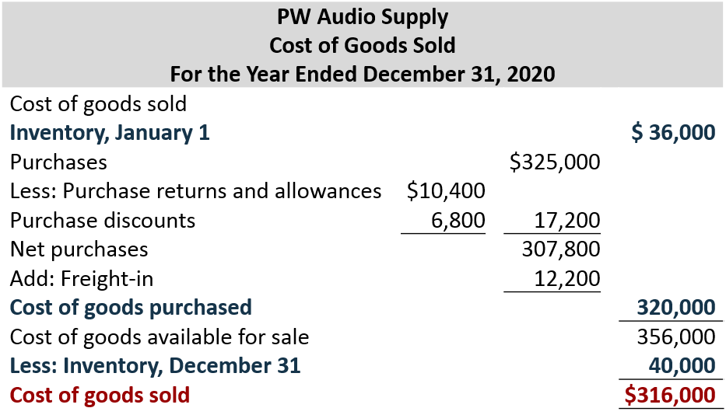
Periodic Inventory System (2 of 2)

Slide 4
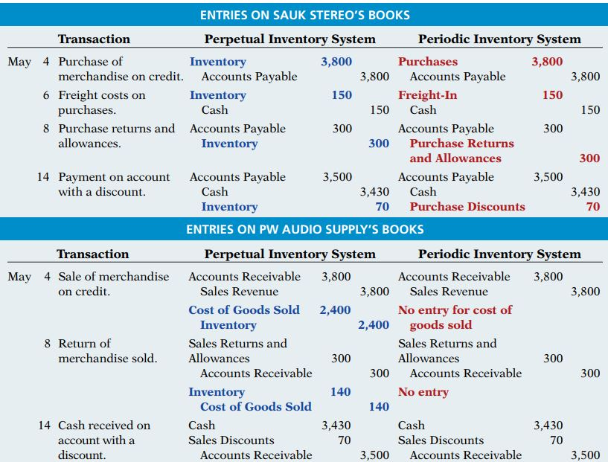

Slide 5
Recording Merchandise Transactions
    Record revenues when sales are made
    Cost of merchandise sold not recorded on date of sale
    Physical inventory count at end of period determines:
      cost of merchandise on hand and
      cost of merchandise sold during the period
    Purchases recorded in Purchases account
    Purchase returns and allowances, Purchase discounts, and Freight costs are recorded in separate accounts

Slide 6
Recording Purchases of Merchandise (1 of 4)
Illustration: On the basis of the sales invoice (Illustration 5.6) and receipt of the merchandise ordered from P W Audio Supply, Sauk Stereo records the $3,800 purchase as follows.
May 4
Purchases
3,800
Accounts Payable
(To record goods purchased on account from P W Audio Supply)
3,800

Slide 7
Recording Purchases of Merchandise (2 of 4)
Freight Costs
Illustration: If Sauk Stereo pays Public Carrier Co. $150 for freight charges on its purchase from P W Audio Supply on May 6, the entry on Sauk Stereo’s books is:
May 6
Freight-In (Transportation-In)
150
Cash
(To record payment of freight on goods purchased)
150

Slide 8
Recording Purchases of Merchandise (3 of 4)
Purchase Returns and Allowances
Illustration: Sauk Stereo returns goods costing $300 to P W Audio Supply and prepares the following entry to recognize the return.
May 8
Accounts Payable
300
Purchase Returns and Allowances
(To record return of goods purchased from P W Audio Supply)
300

Slide 9
Recording Purchases of Merchandise (4 of 4)
Purchase Discounts
Illustration: On May 14, Sauk Stereo pays the balance due on account to PW Audio Supply, taking the 2% cash discount allowed by PW Audio Supply for payment within 10 days. Sauk Stereo records the payment and discount as follows.
May 14
Accounts Payable ($3,800 − $300)
3,500
Purchase Discounts ($3,500 × .02)
70
Cash
(To record payment within the discount period)
3,430

Slide 10
Recording Sales of Merchandise (1 of 3)
Illustration: The seller, PW Audio Supply, records the sale of $3,800 of merchandise to Sauk Stereo on May 4 (sales invoice No. 731, Illustration 5.6) as follows.
May 4
Accounts Receivable
3,800
Sales Revenue
(To record credit sales per invoice #731 to Sauk Stereo)
3,800
No entry is recorded for cost of goods sold at time of sale under a periodic system.

Slide 11
Recording Sales of Merchandise (2 of 3)
Sales Returns and Allowances
Illustration: To record the returned goods received from Sauk Stereo on May 8, PW Audio Supply records the $300 sales return as follows.
May 8
Sales Returns and Allowance
300
Accounts Receivable
(To record credit granted to Sauk Stereo for returned goods)
300

Slide 12
Recording Sales of Merchandise (3 of 3)
Sales Discounts
Illustration: On May 14, PW Audio Supply receives payment of $3,430 on account from Sauk Stereo. PW Audio Supply honors the 2% cash discount and records the payment of Sauk Stereo’s account receivable in full as follows.
May 14
Cash
3,430
Sales Discounts ($3,500 × .02)
70
Accounts Receivable ($3,800 − $300)
(To record collection within 2/10, n/30 discount period from Sauk Stereo)
3,500

